Slide 1

Cloud Excellence Presentation
Team 3
‘Always Something’
Project Overview:
Create and host a webpage that deploys a ‘Hello-World’ application
AUGUST 2021

Slide 2
Agenda
Team member Introductions
Architecture/Design diagram
Tools/Software Environment used
Challenges/Issues/Problems/Your stories
Demo
What have you learned/learned?
What else can we do on the project? - future plan- any design and implementation ideas?
Questions and answers
www.webagesolutions.com|1.877.517.6540

Slide 3





Team Members
JACOB
STUBBE
Technologist
BRADLEY STEPHENSON
Engineer
DANIEL LIM
Engineer
LATOYA
ARRINGTON
Engineer
DONTE SCOTT
Technologist

Slide 4
Technologies and Environment
AWS EC2 Instance
AWS S3 Buckets
AWS CodeDeploy
Git with Github.com
AWS CLI
PowerShell

Slide 5
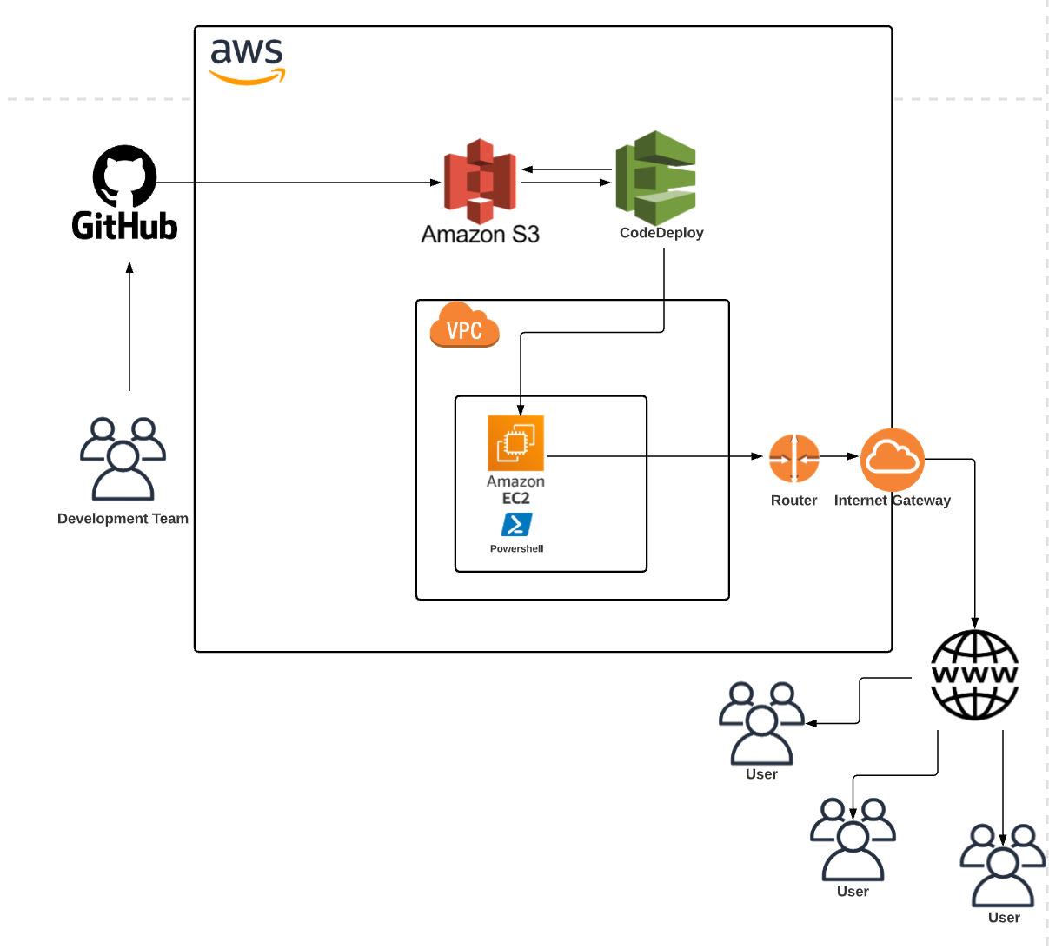
Architecture and Design
Push changes to Github Repository
Added S3 bucket permissions to Github
CodeDeploy uses .zip file/S3 bucket to build website in EC2 server
Instance utilized PowerShell to deploy CodeDeploy agent
Notes:
“So began with a github repository and then used that to push all our changes of the index.html file to that repo, which then goes to our S3 bucket. After this, we used a workflow on github and added permissions with our IAM role and bucket for this to work. We then used CodeDeploy to investigate a revision location of the S3 bucket that we were working with, which searched for the helloworld zip file. The helloworld zip file contains three files to build and host the website on the targeted EC2 instance on a inetpub\wwwroot folder location. Before executing the codedeploy build, we installed the code deploy agent on our ec2 instance through powershell. Once this was pushed, our team noticed the changed to the strings.”

Slide 6
Challenges and Issues
Connecting to AWS through Visual Studio
Deployment of the website inside AWS ECS
Figuring out what permissions to give CodeDeploy to assume roles
Trying to add permissions to IAM user to work with CodeDeploy
Service linked roles (forgot to link them)
Ensuring services are called by appropriate tags
Main v Master difference in Github (legacy)

Slide 7
Demonstration by
Daniel
Notes:
CodeDeploy will use this AppSpec file to copy the index.html file in the application source code's root folder to the c:\inetpub\wwwroot folder on the target Amazon EC2 instance. During the deployment, CodeDeploy will run the before-install.bat batch script on the target Amazon EC2 instance during the BeforeInstall deployment lifecycle event. If this script takes longer than 900 seconds (15 minutes) to run, CodeDeploy will stop the deployment and mark the deployment to the Amazon EC2 instance as failed.

Slide 8
What have we learned?
How to create and deploy an instance
How to configure a Bucket to connect to other services
Create a deployment group and configure it in CodeDeploy
Created a Github profile and repository
Install and configure AWS CLI
Navigate PowerShell
Create and host a webpage

Slide 9
Future State - What we would add
Monitor and React to Deployment Changes in AWS CodeDeploy with Amazon CloudWatch Events
- This would allow our team to detect changes in the state of an Amazon EC2 instance or deployment managed by CodeDeploy, then invoke an action based on rules that we set.
- This is extremely useful for building workflows and processes that are triggered by changes in your deployments
Add a functionality to zipping the file before it uploads and replaces the file in S3 Bucket, and then deploys it automatically (not having to do it manually)
- Would allow the process to run smoothly and increase efficiency

Slide 10
Q & A - Ask us anything!!

Slide 11
Thank You!!!
AUGUST 2021

